Slide 1
Chapter 12: Indexing and Hashing
西电学堂 xt.xidian.edu.cn 搜索“数据库”

Slide 2
Chapter 12: Indexing and Hashing
Basic Concepts
Ordered Indices
B⁺-Tree Index Files
B-Tree Index Files
Static Hashing
Dynamic Hashing
Comparison of Ordered Indexing and Hashing
Index Definition in SQL
Multiple-Key Access

Slide 3
Basic Concepts
用于加快对所需数据的访问的索引机制。
例如，图书馆中的作者目录
搜索键 - 用于在文件中查找记录的属性集的属性。
索引文件由表单的记录（称为索引条目）组成_x000b__x000b_索引文件通常比原始文件小得多
两种基本类型的指数：
有序索引：搜索键按排序顺序存储
哈希索引：使用“哈希函数”将搜索键均匀分布在“存储桶”中。
search-key
pointer

Slide 4
Ordered Indices
In an ordered index, index entries are stored sorted on the search key value. E.g., author catalog in library.
主索引：在按顺序排序的文件中，其搜索键指定文件的顺序的索引.
  也称为聚类索引
  主索引的搜索键通常是主键，但不一定是主键。
二级索引：其搜索键指定的顺序与文件的顺序不同的索引.
  也称为非聚类索引.
索引顺序文件：带有主索引的有序顺序文件。

Slide 5

Dense Index Files
密集索引 — 为文件中的每个搜索键值显示索引记录。
E.g. index on ID attribute of instructor relation

Slide 6

Dense Index Files (Cont.)
Dense index on dept_name, with instructor file sorted on dept_name

Slide 7

Sparse Index Files
稀疏索引：仅包含部分搜索键值的索引记录。
  当记录按搜索键顺序排序时适用
要查找具有搜索键值 K 的记录，请:
  查找具有最大搜索键值 < K 的索引记录
  从索引记录指向的记录开始按顺序搜索文件

Slide 8

Sparse Index Files (Cont.)
Compared to dense indices:
  减少插入和删除的空间和维护开销。
  通常比用于查找记录的密集索引慢。
良好的权衡：稀疏索引，文件中每个块都有一个索引条目，对应于块中的最小搜索键值。

Slide 9

Secondary Indices Example
Secondary index on salary field of instructor
索引记录指向一个存储桶，该存储桶包含指向具有该特定搜索键值的所有实际记录的指针。
二级索引必须密集

Slide 10
Primary and Secondary Indices
在搜索记录时，索引提供了巨大的好处。
使用主索引的顺序扫描效率很高，但使用二级索引的顺序扫描成本很高
  每次记录访问都可能从磁盘中获取一个新块
  块提取大约需要 5 到 10 毫秒，而内存访问大约需要 100 纳秒
但是：更新索引会给数据库修改带来开销 -- 当一个文件被修改时，文件上的每个索引都必须更新，

Slide 11
Multilevel Index
如果内存中无法容纳主索引，则访问成本会变得很高。
  外部索引 – 主索引的稀疏索引
如果外部索引太大而无法放入主内存中，则可以创建另一级索引，依此类推。
在插入或删除文件时，必须更新所有级别的索引。
  内部索引 – 主索引文件
解决方法：将磁盘上保存的主索引视为顺序文件，并在其上构造稀疏索引。

Slide 12
Multilevel Index (Cont.)

Slide 13
Index Update: Deletion
如果已删除的记录是文件中唯一具有特定搜索键值的记录，则搜索键也会从索引中删除。
单级索引条目删除:
  密集索引 – 删除搜索键类似于删除文件记录.
  稀疏索引–
    如果索引中存在搜索键的条目，则通过将索引中的条目替换为文件中的下一个搜索键值（按搜索键顺序）来删除该条目。
    如果下一个搜索键值已具有索引条目，则将删除该条目，而不是替换该条目。

Slide 14
Index Update: Insertion
单级索引插入:
  使用要插入的记录中显示的搜索键值执行查找.
  Dense indices –如果索引中未显示 Search-Key 值，请插入该值.
  Sparse indices – if index stores an entry for each block of the file, no change needs to be made to the index unless a new block is created.
    If a new block is created, the first search-key value appearing in the new block is inserted into the index.
Multilevel insertion and deletion: algorithms are simple extensions of the single-level algorithms

Slide 15
Secondary Indices
通常，人们希望查找某个字段（不是主索引的搜索键）中值满足某些条件的所有记录。
  Example 1:在按 ID 顺序存储的教师关系中，我们可能希望查找特定部门的所有教师
  Example 2:如上所述，但我们希望找到具有指定薪水或薪水在指定值范围内的所有讲师
我们可以有一个二级索引，每个搜索键值都有一个索引记录

Slide 16
B⁺-Tree Index Files
B⁺-tree indices are an alternative to indexed-sequential files.
Disadvantage of indexed-sequential files
  performance degrades as file grows, since many overflow blocks get created.
  Periodic reorganization of entire file is required.
Advantage of B⁺-tree index files:
  automatically reorganizes itself with small, local, changes, in the face of insertions and deletions.
  Reorganization of entire file is not required to maintain performance.
(Minor) disadvantage of B⁺-trees:
  extra insertion and deletion overhead, space overhead.
Advantages of B⁺-trees outweigh disadvantages
  B⁺-trees are used extensively

Slide 17

Example of B⁺-Tree

Slide 18
B⁺-Tree Index Files (Cont.)
A B⁺-tree is a rooted tree satisfying the following properties:
All paths from root to leaf are of the same length
Each node that is not a root or a leaf has between ⎡n/2⎤ and n children.
A leaf node has between ⎡(n–1)/2⎤ and n–1 values
Special cases:
  If the root is not a leaf, it has at least 2 children.
  If the root is a leaf (that is, there are no other nodes in the tree), it can have between 0 and (n–1) values.

Slide 19
B⁺-Tree Node Structure
Typical node
  K_{i} are the search-key values
  P_{i} are pointers to children (for non-leaf nodes) or pointers to records or buckets of records (for leaf nodes).
The search-keys in a node are ordered
K₁ < K₂ < K₃ < . . . < K_{n–1}
(Initially assume no duplicate keys, address duplicates later)

Slide 20

Leaf Nodes in B⁺-Trees
Properties of a leaf node:
For i = 1, 2, . . ., n–1, pointer P_{i} points to a file record with search-key value K_{i},
If L_{i}, L_{j} are leaf nodes and i < j, L_{i}’s search-key values are less than or equal to L_{j}’s search-key values
P_{n} points to next leaf node in search-key order

Slide 21
Non-Leaf Nodes in B⁺-Trees
Non leaf nodes form a multi-level sparse index on the leaf nodes. For a non-leaf node with m pointers:
  All the search-keys in the subtree to which P₁ points are less than K₁
  For 2 ≤ i ≤ n – 1, all the search-keys in the subtree to which P_{i} points have values greater than or equal to K_{i–1} and less than K_{i}
  All the search-keys in the subtree to which P_{n} points have values greater than or equal to K_{n–1}

Slide 22

Example of B⁺-tree
B⁺-tree for instructor file (n = 6)
Leaf nodes must have between 3 and 5 values
(⎡(n–1)/2⎤ and n –1, with n = 6).
Non-leaf nodes other than root must have between 3 and 6 children (⎡(n/2⎤ and n with n =6).
Root must have at least 2 children.

Slide 23
Observations about B⁺-trees
Since the inter-node connections are done by pointers, “logically” close blocks need not be “physically” close.
The non-leaf levels of the B⁺-tree form a hierarchy of sparse indices.
The B⁺-tree contains a relatively small number of levels
    Level below root has at least 2* ⎡n/2⎤ values
    Next level has at least 2* ⎡n/2⎤ * ⎡n/2⎤ values
    .. etc.
  If there are K search-key values in the file, the tree height is no more than ⎡ log_{⎡n/2⎤}(K)⎤
  thus searches can be conducted efficiently.
Insertions and deletions to the main file can be handled efficiently, as the index can be restructured in logarithmic time (as we shall see).

Slide 24

Queries on B⁺-Trees
Find record with search-key value V.
  C=root
  While C is not a leaf node {
    Let i be least value s.t. V ≤ K_{i}.
    If no such exists, set C = last non-null pointer in C
    Else { if (V= K_{i} ) Set C = P_{i +1} else set C = P_{i}}
    }
  Let i be least value s.t. K_{i} = V
  If there is such a value i, follow pointer P_{i} to the desired record.
  Else no record with search-key value k exists.

Slide 25
Queries on B⁺⁻Trees (Cont.)
If there are K search-key values in the file, the height of the tree is no more than ⎡log_{⎡n/2⎤}(K)⎤.
A node is generally the same size as a disk block, typically 4 kilobytes
  and n is typically around 100 (40 bytes per index entry).
With 1 million search key values and n = 100
  at most log₅₀(1,000,000) = 4 nodes are accessed in a lookup.
Contrast this with a balanced binary tree with 1 million search key values — around 20 nodes are accessed in a lookup
  above difference is significant since every node access may need a disk I/O, costing around 20 milliseconds

Slide 26
Updates on B⁺-Trees: Insertion
Find the leaf node in which the search-key value would appear
If the search-key value is already present in the leaf node
  Add record to the file
  If necessary add a pointer to the bucket.
If the search-key value is not present, then
  add the record to the main file (and create a bucket if necessary)
  If there is room in the leaf node, insert (key-value, pointer) pair in the leaf node
  Otherwise, split the node (along with the new (key-value, pointer) entry) as discussed in the next slide.

Slide 27
Updates on B⁺-Trees: Insertion (Cont.)
Splitting a leaf node:
  take the n (search-key value, pointer) pairs (including the one being inserted) in sorted order. Place the first ⎡n/2⎤ in the original node, and the rest in a new node.
  let the new node be p, and let k be the least key value in p. Insert (k,p) in the parent of the node being split.
  If the parent is full, split it and propagate the split further up.
Splitting of nodes proceeds upwards till a node that is not full is found.
  In the worst case the root node may be split increasing the height of the tree by 1.
Result of splitting node containing Brandt, Califieri and Crick on inserting Adams
Next step: insert entry with (Califieri,pointer-to-new-node) into parent

Slide 28
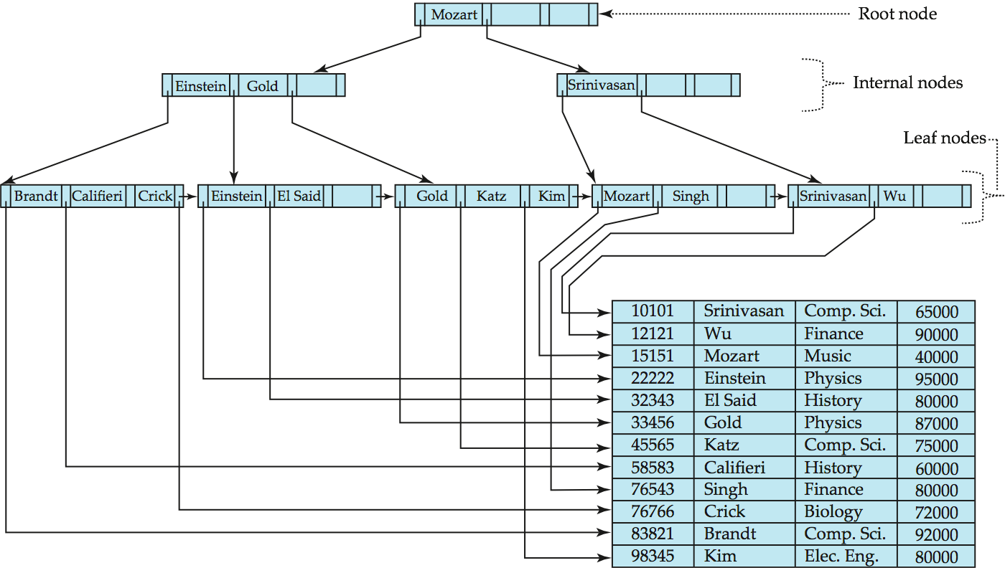
B⁺-Tree Insertion
B⁺-Tree before and after insertion of “Adams”

Slide 29
Insertion in B⁺-Trees (Cont.)
Splitting a non-leaf node: when inserting (k,p) into an already full internal node N
  Copy N to an in-memory area M with space for n+1 pointers and n keys
  Insert (k,p) into M
  Copy P₁,K₁, …, K _{⎡n/2⎤-1},P _{⎡n/2⎤} from M back into node N
  Copy P_{⎡n/2⎤+1},K _{⎡n/2⎤+1},…,K_{n},P_{n+1} from M into newly allocated node N’
  Insert (K _{⎡n/2⎤},N’) into parent N
Read pseudocode in book!
Califieri
Adams Brandt Califieri Crick
Adams Brandt
Crick

Slide 30
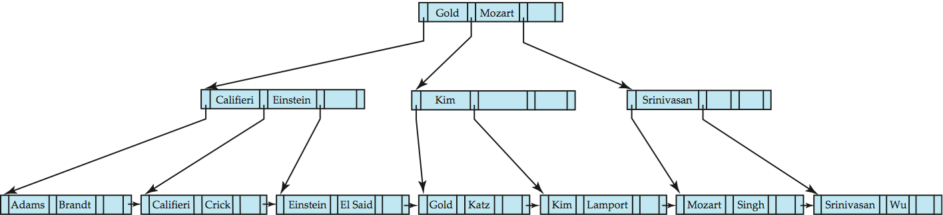
B⁺-Tree Insertion
B⁺-Tree before and after insertion of “Lamport”

Slide 31
Updates on B⁺-Trees: Deletion
Find the record to be deleted, and remove it from the main file and from the bucket (if present)
Remove (search-key value, pointer) from the leaf node if there is no bucket or if the bucket has become empty
If the node has too few entries due to the removal, and the entries in the node and a sibling fit into a single node, then merge siblings:
  Insert all the search-key values in the two nodes into a single node (the one on the left), and delete the other node.
  Delete the pair (K_{i–1}, P_{i}), where P_{i} is the pointer to the deleted node, from its parent, recursively using the above procedure.

Slide 32
Updates on B⁺-Trees: Deletion
Otherwise, if the node has too few entries due to the removal, but the entries in the node and a sibling do not fit into a single node, then redistribute pointers:
  Redistribute the pointers between the node and a sibling such that both have more than the minimum number of entries.
  Update the corresponding search-key value in the parent of the node.
The node deletions may cascade upwards till a node which has ⎡n/2⎤ or more pointers is found.
If the root node has only one pointer after deletion, it is deleted and the sole child becomes the root.

Slide 33
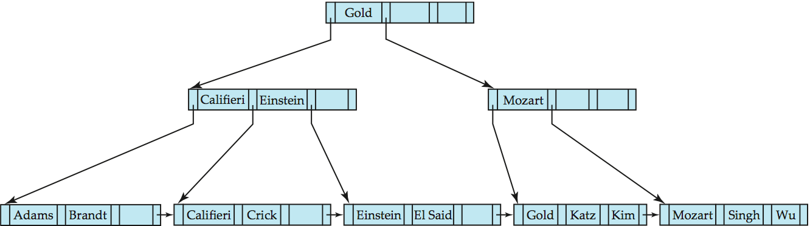
Examples of B⁺-Tree Deletion
Before and after deleting “Srinivasan”
Deleting “Srinivasan” causes merging of under-full leaves

Slide 34
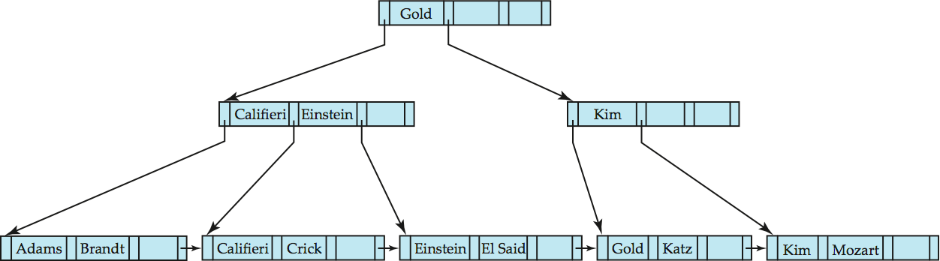
Examples of B⁺-Tree Deletion (Cont.)
Before and after deleting of “Singh” and “Wu”
Leaf containing Singh and Wu became underfull, and borrowed a value Kim from its left sibling
Search-key value in the parent changes as a result

Slide 35
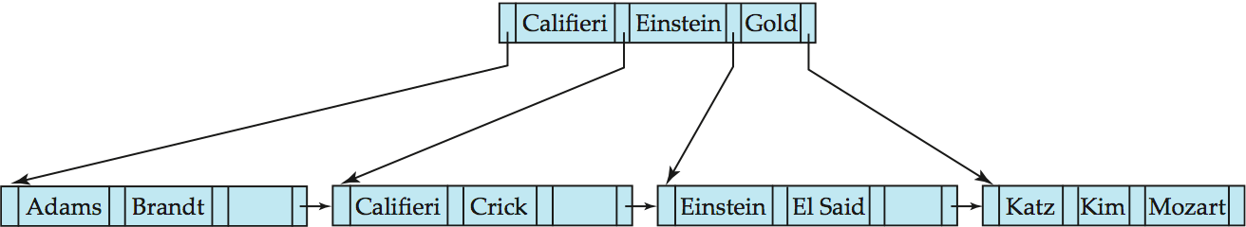
Example of B⁺-tree Deletion (Cont.)
Before and after deletion of “Gold”
Node with Katz became underfull, and was merged with its sibling
Parent node becomes underfull, and is merged with its sibling
  Value separating two nodes (at the parent) is pulled down when merging
Root node then has only one child, and is deleted

Slide 36
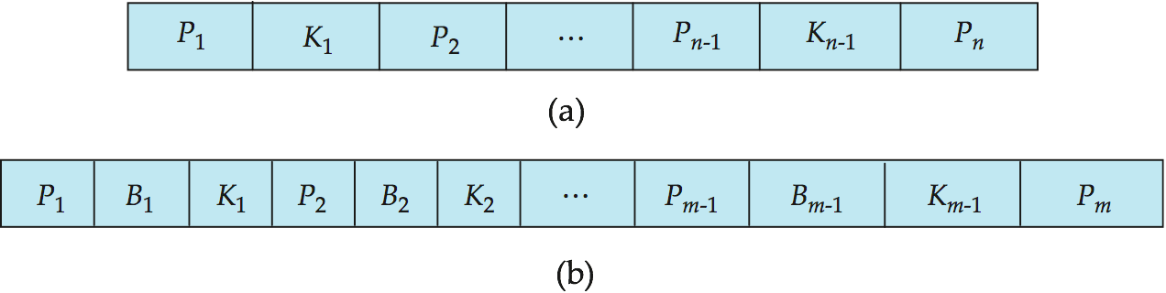
B-Tree Index Files
Similar to B+-tree, but B-tree allows search-key values to appear only once; eliminates redundant storage of search keys.
Search keys in nonleaf nodes appear nowhere else in the B-tree; an additional pointer field for each search key in a nonleaf node must be included.
Generalized B-tree leaf node
Nonleaf node – pointers Bi are the bucket or file record pointers.

Slide 37
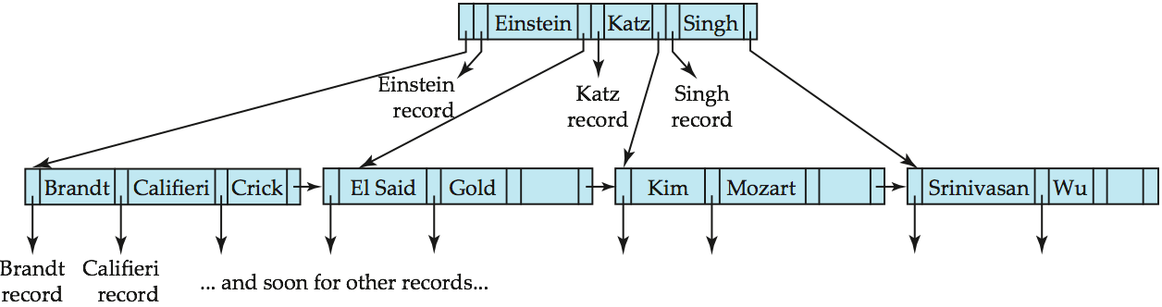
B-Tree Index File Example
B-tree (above) and B+-tree (below) on same data

Slide 38
B-Tree Index Files (Cont.)
Advantages of B-Tree indices:
  May use less tree nodes than a corresponding B⁺-Tree.
  Sometimes possible to find search-key value before reaching leaf node.
Disadvantages of B-Tree indices:
  Only small fraction of all search-key values are found early
  Non-leaf nodes are larger, so fan-out is reduced. Thus, B-Trees typically have greater depth than corresponding B⁺-Tree
  Insertion and deletion more complicated than in B⁺-Trees
  Implementation is harder than B⁺-Trees.
Typically, advantages of B-Trees do not out weigh disadvantages.

Slide 39
Multiple-Key Access
对某些类型的查询使用多个索引。
Example:
  select ID
  from instructor
  where dept_name = “Finance” and salary = 80000
使用单个属性的索引处理查询的可能策略:
  1. Use index on dept_name to find instructors with department name Finance; test salary = 80000
  2. Use index on salary to find instructors with a salary of $80000; test dept_name = “Finance”.
  3. Use dept_name index to find pointers to all records pertaining to the “Finance” department. Similarly use index on salary. Take intersection of both sets of pointers obtained.

Slide 40
Indices on Multiple Keys
Composite search keys are search keys containing more than one attribute
  E.g. (dept_name, salary)
Lexicographic ordering: (a₁, a₂) < (b₁, b₂) if either
  a₁ < b₁, or
  a₁=b₁ and a₂ < b₂

Slide 41
Indices on Multiple Attributes
Suppose we have an index on combined search-key
(dept_name, salary).
With the where clause
where dept_name = “Finance” and salary = 80000
the index on (dept_name, salary) can be used to fetch only records that satisfy both conditions.
  使用单独的索引效率较低 - 我们可能会获取许多仅满足其中一个条件的记录（或指针）。
Can also efficiently handle
where dept_name = “Finance” and salary < 80000
But cannot efficiently handle
where dept_name < “Finance” and balance = 80000
  May fetch many records that satisfy the first but not the second condition

Slide 42
Hashing

Slide 43
Static Hashing
存储桶是包含一条或多条记录的存储单元（存储桶通常是磁盘块）。
在哈希文件组织中，我们使用哈希函数直接从记录的搜索键值中获取记录的存储桶。
哈希函数 h 是从所有搜索键值 K 的集合到所有存储桶地址 B 的集合的函数。
哈希函数用于定位访问、插入和删除的记录。
具有不同搜索键值的记录可以映射到同一存储桶;因此，必须按顺序搜索整个存储桶才能找到记录。

Slide 44
Example of Hash File Organization
Hash file organization of instructor file, using dept_name as key
(See figure in next slide.)
There are 10 buckets,
The binary representation of the ith character is assumed to be the integer i.
The hash function returns the sum of the binary representations of the characters modulo 10
  E.g. h(Music) = 1
  h(History) = 2
  h(Physics) = 3
  h(Elec. Eng.) = 3
  h(Finance) = 4
  …

Slide 45

Example of Hash File Organization
Hash file organization of instructor file, using dept_name as key

Slide 46
Hash Functions
最差哈希函数将所有搜索键值映射到同一存储桶;这使得访问时间与文件中的搜索键值数成正比。
理想的哈希函数是统一的，即从所有可能值的集合中为每个存储桶分配相同数量的搜索键值。
理想的哈希函数是随机的，因此无论文件中搜索键值的实际分布如何，每个存储桶都将分配相同数量的记录。
典型的哈希函数对搜索键的内部二进制表示形式执行计算。
例如，对于字符串搜索键，可以添加字符串中所有字符的二进制表示形式，并且可以返回存储桶数量的总和模。

Slide 47
存储桶溢出的处理
存储桶溢出可能是由于以下原因造成的
Although the probability of bucket overflow can be reduced, it cannot be eliminated; it is handled by using overflow buckets.
存储桶不足
记录分布偏斜。 这可能是由于两个原因造成的：
多条记录具有相同的搜索键值
选择的哈希函数产生键值的不均匀分布

Slide 48
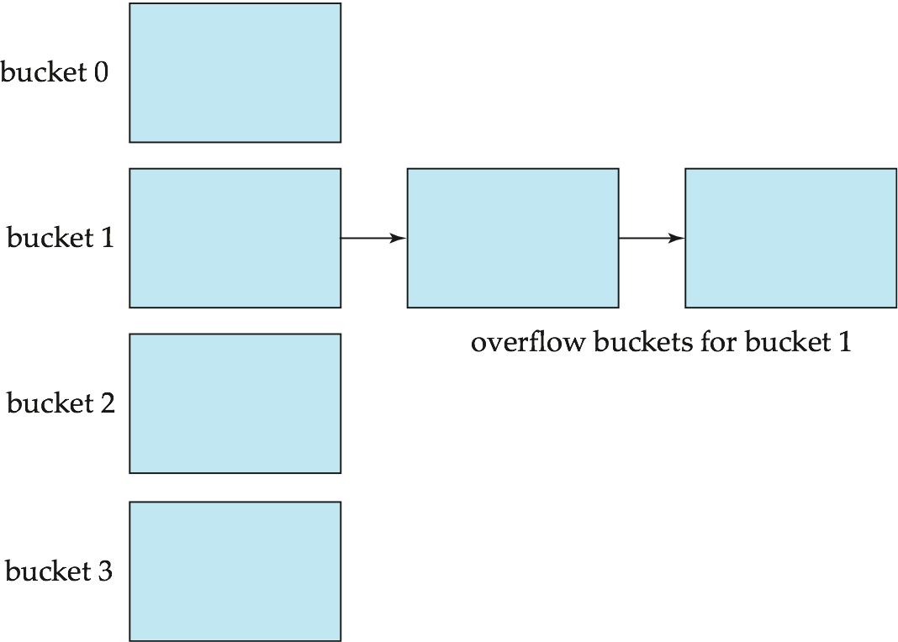
Handling of Bucket Overflows (Cont.)
溢出链接 – 给定存储桶的溢出存储桶在链表中链接在一起.
上述方案称为闭合哈希.
  另一种称为开放哈希的替代方法（不使用溢出存储桶）不适用于数据库应用程序。

Slide 49
Hash Indices
哈希不仅可用于文件组织，还可用于创建索引结构。
哈希索引将搜索键及其关联的记录指针组织到哈希文件结构中。
严格来说，哈希索引始终是二级索引
如果文件本身是使用哈希来组织的，则不需要使用相同的搜索键对其进行单独的主哈希索引。
但是，我们使用术语哈希索引来指代二级索引结构和哈希组织文件。

Slide 50
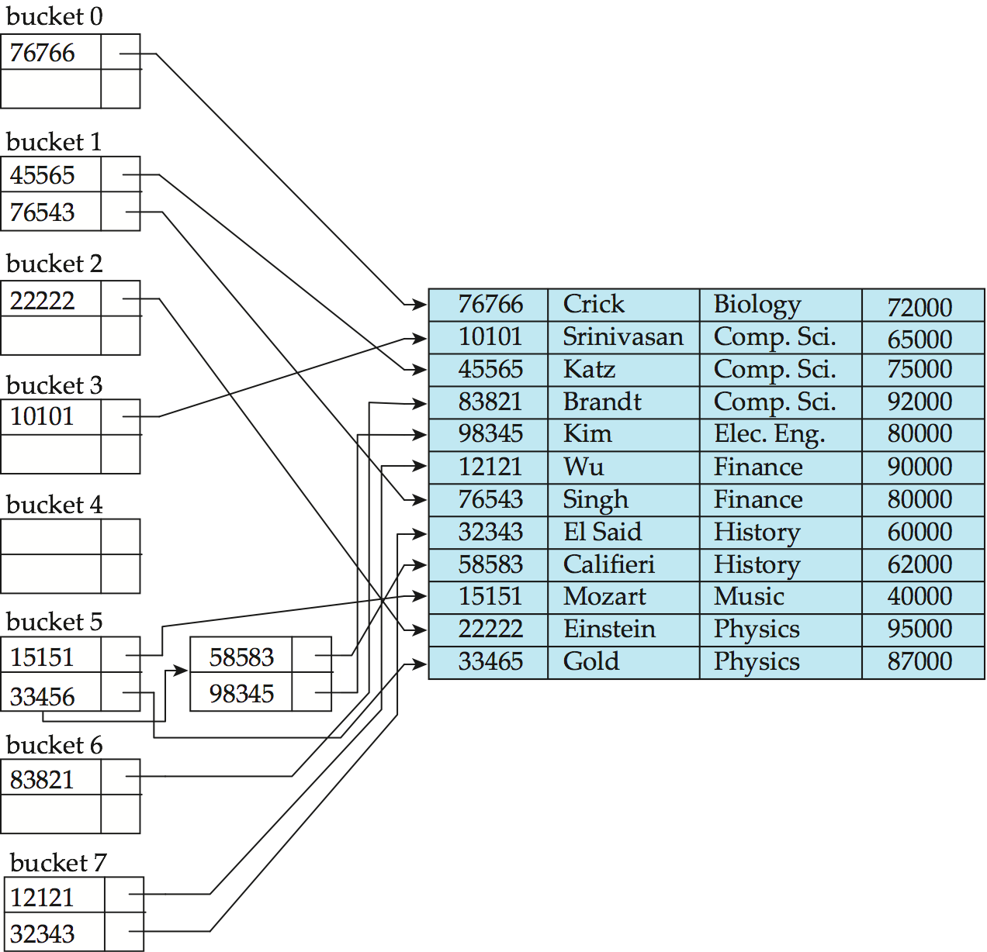
Example of Hash Index
hash index on instructor, on attribute ID

Slide 51
Deficiencies of Static Hashing
In static hashing, function h maps search-key values to a fixed set of B of bucket addresses. Databases grow or shrink with time.
  If initial number of buckets is too small, and file grows, performance will degrade due to too much overflows.
  If space is allocated for anticipated growth, a significant amount of space will be wasted initially (and buckets will be underfull).
  If database shrinks, again space will be wasted.
One solution: periodic re-organization of the file with a new hash function
  Expensive, disrupts normal operations
Better solution: allow the number of buckets to be modified dynamically.

Slide 52
Dynamic Hashing
适用于大小增长和缩小的数据库
Extendable hashing – one form of dynamic hashing
  Hash function generates values over a large range — typically b-bit integers, with b = 32.
  At any time use only a prefix of the hash function to index into a table of bucket addresses.
  Let the length of the prefix be i bits, 0 ≤ i ≤ 32.
    Bucket address table size = 2^{i.} Initially i = 0
    Value of i grows and shrinks as the size of the database grows and shrinks.
  Multiple entries in the bucket address table may point to a bucket. Thus, actual number of buckets is < 2^{i}
    The number of buckets also changes dynamically due to coalescing and splitting of buckets.
允许动态修改哈希函数

Slide 53
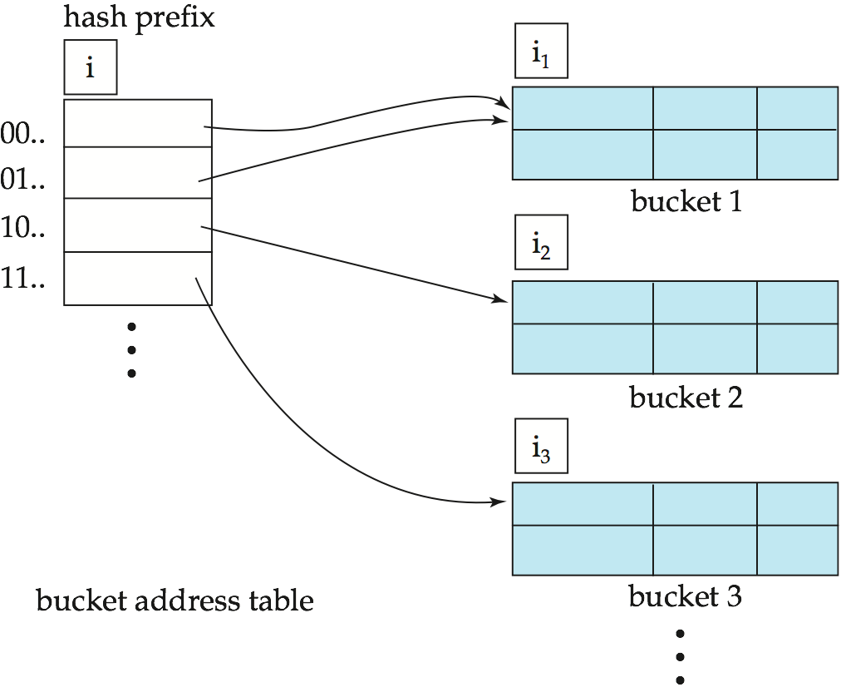
General Extendable Hash Structure
In this structure, i₂ = i₃ = i, whereas i₁ = i – 1

Slide 54
Use of Extendable Hash Structure
Each bucket j stores a value i_{j}
  All the entries that point to the same bucket have the same values on the first i_{j} bits.
To locate the bucket containing search-key K_{j}:
  1. Compute h(K_{j}) = X
  2. Use the first i high order bits of X as a displacement into bucket address table, and follow the pointer to appropriate bucket
To insert a record with search-key value K_{j}
  follow same procedure as look-up and locate the bucket, say j.
  If there is room in the bucket j insert record in the bucket.
  Else the bucket must be split and insertion re-attempted

Slide 55
Insertion in Extendable Hash Structure (Cont)
To split a bucket j when inserting record with search-key value K_{j}:
If i > i_{j} (more than one pointer to bucket j)
  allocate a new bucket z, and set i_{j} = i_{z} = (i_{j} + 1)
  Update the second half of the bucket address table entries originally pointing to j, to point to z
  remove each record in bucket j and reinsert (in j or z)
  recompute new bucket for K_{j} and insert record in the bucket (further splitting is required if the bucket is still full)
If i = i_{j} (only one pointer to bucket j)
  If i reaches some limit b, or too many splits have happened in this insertion, create an overflow bucket
  Else
    increment i and double the size of the bucket address table.
    replace each entry in the table by two entries that point to the same bucket.
    recompute new bucket address table entry for K_{j}
    Now i > i_{j} so use the first case above.

Slide 56
Deletion in Extendable Hash Structure
To delete a key value,
  locate it in its bucket and remove it.
  The bucket itself can be removed if it becomes empty (with appropriate updates to the bucket address table).
  Coalescing of buckets can be done (can coalesce only with a “buddy” bucket having same value of i_{j} and same i_{j} –1 prefix, if it is present)
  Decreasing bucket address table size is also possible
    Note: decreasing bucket address table size is an expensive operation and should be done only if number of buckets becomes much smaller than the size of the table

Slide 57
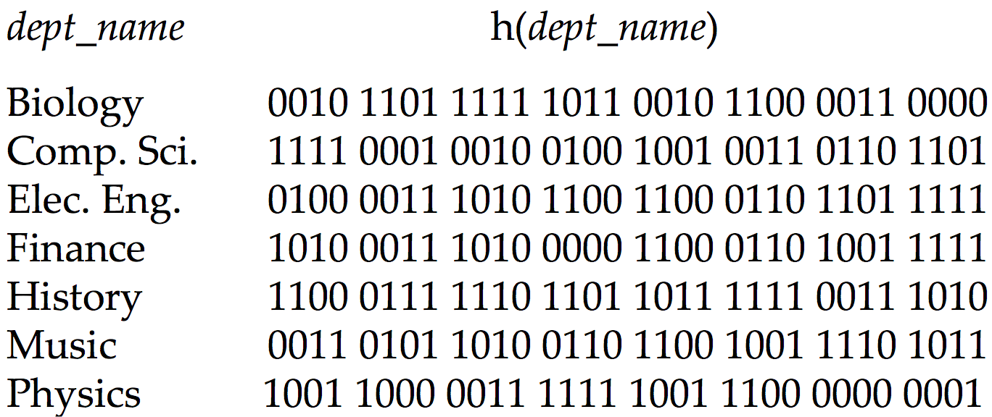
Use of Extendable Hash Structure: Example

Slide 58
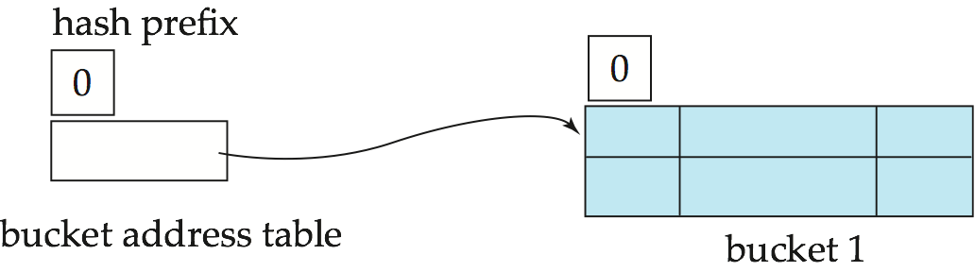
Example (Cont.)
Initial Hash structure; bucket size = 2

Slide 59
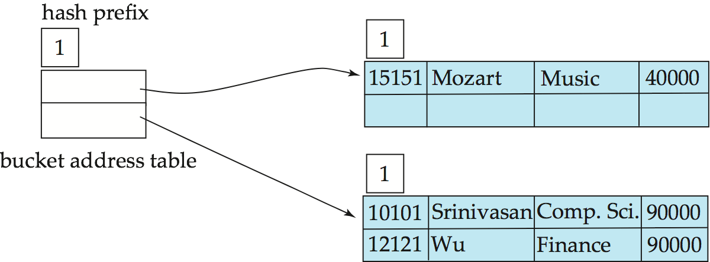
Example (Cont.)
Hash structure after insertion of “Mozart”, “Srinivasan”,
and “Wu” records

Slide 60
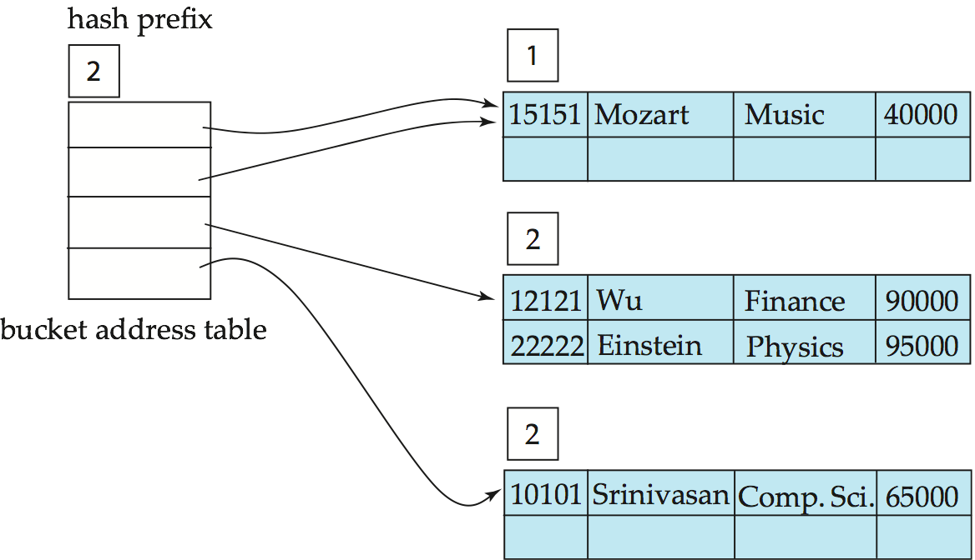
Example (Cont.)
Hash structure after insertion of Einstein record

Slide 61
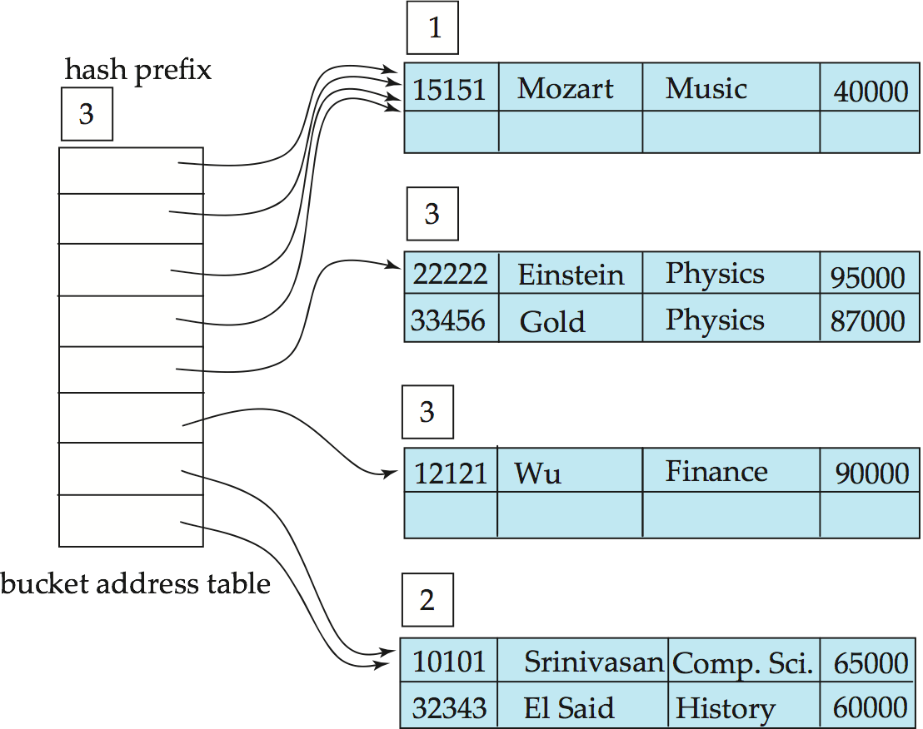
Example (Cont.)
Hash structure after insertion of Gold and El Said records

Slide 62
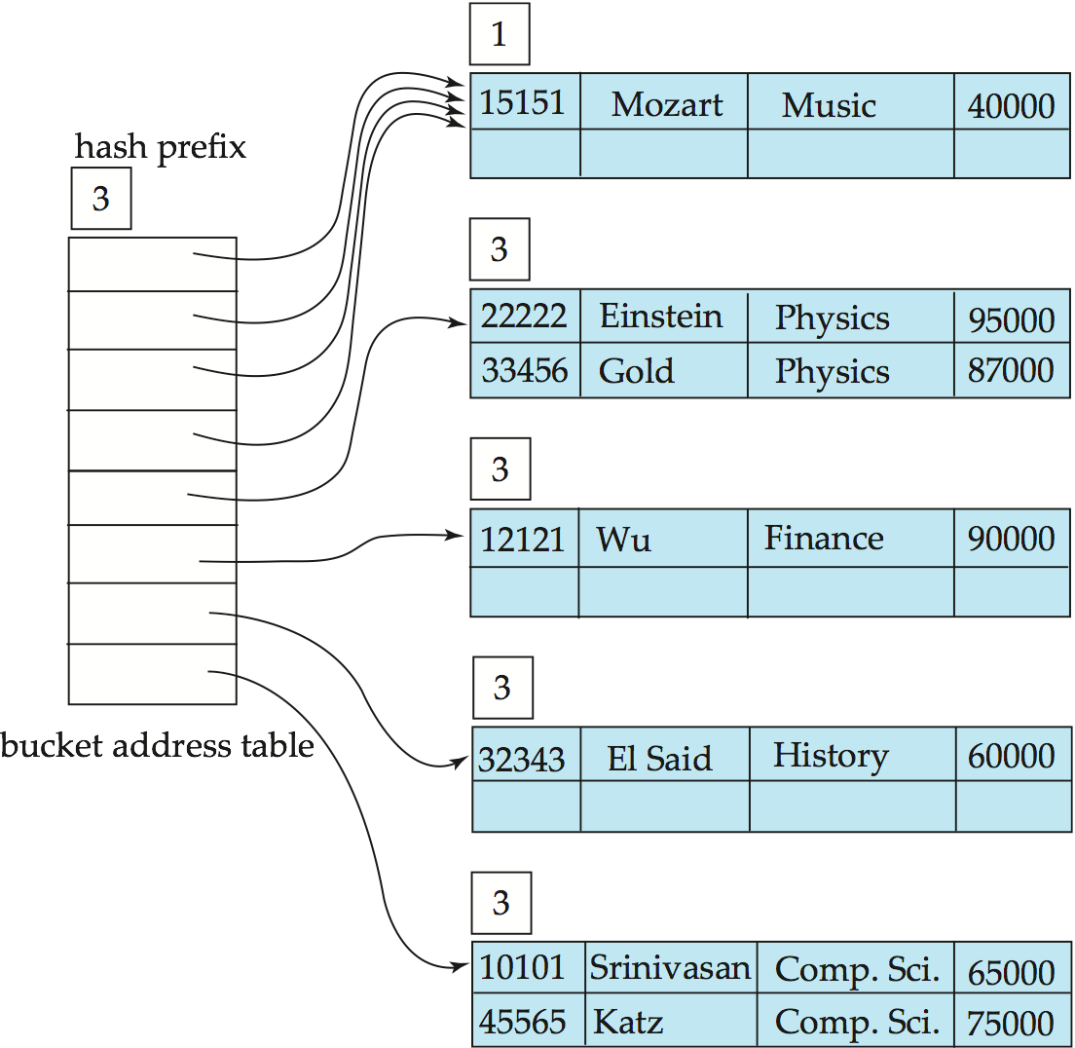
Example (Cont.)
Hash structure after insertion of Katz record

Slide 63
Extendable Hashing vs. Other Schemes
Benefits of extendable hashing:
  Hash performance does not degrade with growth of file
  Minimal space overhead
Disadvantages of extendable hashing
  Extra level of indirection to find desired record
  Bucket address table may itself become very big (larger than memory)
    Cannot allocate very large contiguous areas on disk either
    Solution: B⁺-tree structure to locate desired record in bucket address table
  Changing size of bucket address table is an expensive operation
Linear hashing is an alternative mechanism
  Allows incremental growth of its directory (equivalent to bucket address table)
  At the cost of more bucket overflows

Slide 64
Comparison of Ordered Indexing and Hashing
Cost of periodic re-organization
Relative frequency of insertions and deletions
Is it desirable to optimize average access time at the expense of worst-case access time?
Expected type of queries:
  Hashing is generally better at retrieving records having a specified value of the key.
  If range queries are common, ordered indices are to be preferred
In practice:
  PostgreSQL supports hash indices, but discourages use due to poor performance
  Oracle supports static hash organization, but not hash indices
  SQLServer supports only B⁺-trees

Slide 65
Bitmap Indices

Slide 66
Bitmap Indices
位图索引是一种特殊类型的索引，旨在对多个键进行高效查询
Records in a relation are assumed to be numbered sequentially from, say, 0
  Given a number n it must be easy to retrieve record n
    Particularly easy if records are of fixed size
Applicable on attributes that take on a relatively small number of distinct values
  E.g. gender, country, state, …
  E.g. income-level (income broken up into a small number of levels such as 0-9999, 10000-19999, 20000-50000, 50000- infinity)
A bitmap is simply an array of bits

Slide 67
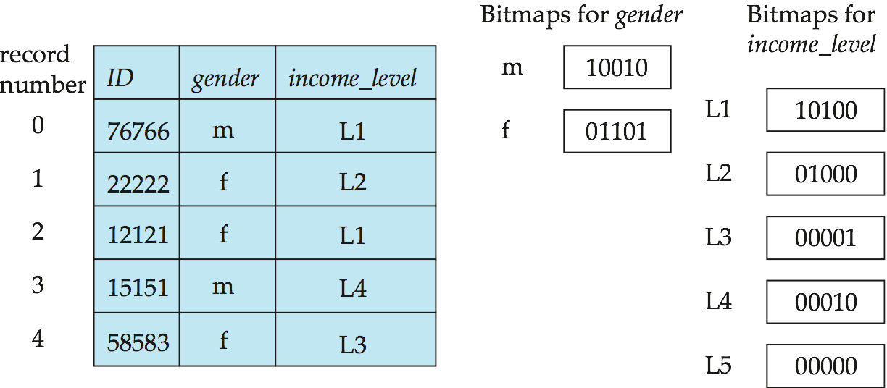
Bitmap Indices (Cont.)
In its simplest form a bitmap index on an attribute has a bitmap for each value of the attribute
  Bitmap has as many bits as records
  In a bitmap for value v, the bit for a record is 1 if the record has the value v for the attribute, and is 0 otherwise

Slide 68
Bitmap Indices (Cont.)
Queries are answered using bitmap operations
  Intersection (and)
  Union (or)
  Complementation (not)
Each operation takes two bitmaps of the same size and applies the operation on corresponding bits to get the result bitmap
  E.g. Find males with income level L1:
  10010 AND 10100 = 10000
    Can then retrieve required tuples.
    Counting number of matching tuples is even faster

Slide 69
Bitmap Indices (Cont.)
Bitmap indices generally very small compared with relation size
  E.g. if record is 100 bytes, space for a single bitmap is 1/800 of space used by relation.
    If number of distinct attribute values is 8, bitmap is only 1% of relation size

Slide 70
Index Definition in SQL
Create an index
  create index <index-name> on <relation-name>
  (<attribute-list>)
  E.g.: create index b-index on branch(branch_name)
Use create unique index to indirectly specify and enforce the condition that the search key is a candidate key is a candidate key.
  Not really required if SQL unique integrity constraint is supported
To drop an index
  drop index <index-name>
Most database systems allow specification of type of index, and clustering.

Slide 71
什么时候用索引
经常要用于查询的列（如where id=?）；
经常要用于排序(order by)，分组(group by)的列;
有值唯一性限制的列，比如说主键、身份证号等

Slide 72
什么时候不要用索引
数据更新比查询性能要求要高的情况下不要使用索引（索引也要进行更新）;
不要盲目的给表建太多索引（索引本身也要占用存储空间）；
不要给不经常使用的列建索引；
不要给高重复值的列建索引（比如：性别）;
不要给img, tex, bit数据类型使用索引，因为这种字段一般使用很少，且数据量太大

Slide 73
End of Chapter

